Slide 1
Chi-Square Test of Independence
Slides developed by Mine Çetinkaya-Rundel of OpenIntro
The slides may be copied, edited, and/or shared via the CC BY-SA license
Some images may be included under fair use guidelines (educational purposes)

Slide 2
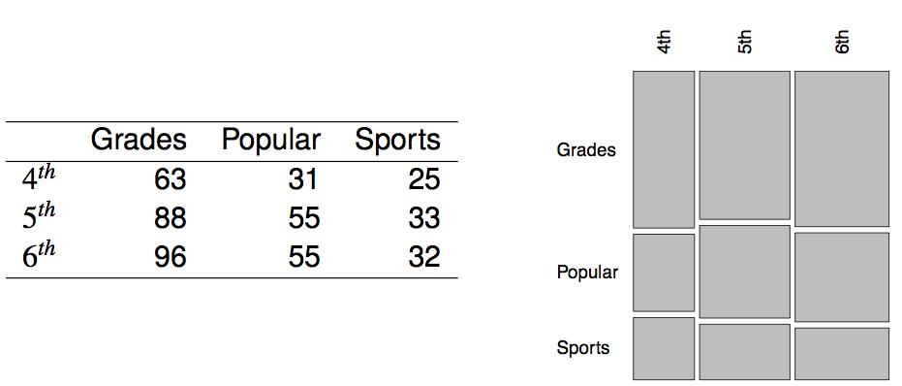
Popular kids
In the dataset popular, students in grades 4-6 were asked whether good grades, athletic ability, or popularity was most important to them. A two-way table separating the students by grade and by choice of most important factor is shown below. Do these data provide evidence to suggest that goals vary by grade?

Slide 3
Chi-square test of independence
The hypotheses are:
H₀: Grade and goals are independent. Goals do not vary by grade.
H_{A}: Grade and goals are dependent. Goals vary by grade.

Slide 4
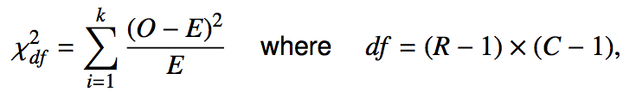
Chi-square test of independence
The hypotheses are:
H₀: Grade and goals are independent. Goals do not vary by grade.
H_{A}: Grade and goals are dependent. Goals vary by grade.
The test statistic is calculated as
where k is the number of cells, R is the number of rows, and C is the number of columns.
Note: we calculate df differently for one-way and two-way tables.
The p-value is the area under the χ²_{df} curve, above the calculated test statistic.

Slide 5

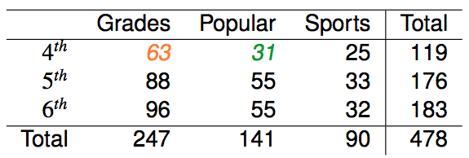


Expected counts in two-way tables

Slide 6
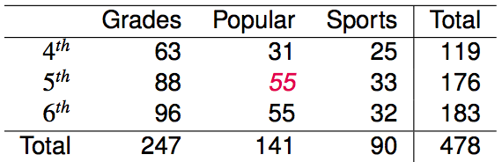
Expected counts in two-way tables
What is the expected count for the highlighted cell?
176 x 141 / 478
119 x 141 / 478
176 x 247 / 478
176 x 478 / 478

Slide 7
Expected counts in two-way tables
What is the expected count for the highlighted cell?
176 x 141 / 478
119 x 141 / 478
176 x 247 / 478
176 x 478 / 478
→ 52
more than expected # of 5th graders
have a goal of being popular

Slide 8
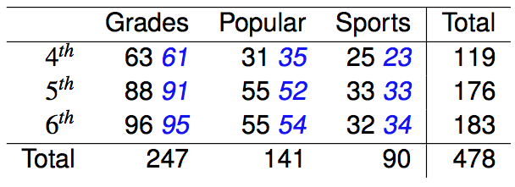

Calculating the test statistic in two-way tables
Expected counts are shown in blue next to the observed counts.

Slide 9
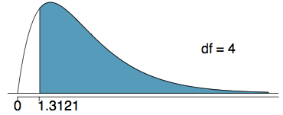
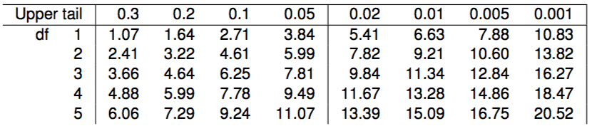
Calculating the p-value
Which of the following is the correct p-value for this hypothesis test?
χ²_{df} = 1.3121 df = 4
more than 0.3
between 0.3 and 0.2
between 0.2 and 0.1
between 0.1 and 0.05
less than 0.001

Slide 10
Calculating the p-value
Which of the following is the correct p-value for this hypothesis test?
χ²_{df} = 1.3121 df = 4
more than 0.3
between 0.3 and 0.2
between 0.2 and 0.1
between 0.1 and 0.05
less than 0.001

Slide 11
Conclusion
Do these data provide evidence to suggest that goals vary by grade?
H₀: Grade and goals are independent. Goals do not vary by grade.
H_{A}: Grade and goals are dependent. Goals vary by grade.
Since the p-value is large, we fail to reject H₀.The data do not provide convincing evidence that grade and goals are dependent. It doesn't appear that goals vary by grade.

